Slide 1
Promouvoir les besoins et intérêts des aidants proches à travers l’UE
Vers une stratégie européenne inclusive
Semaine des Aidants Proches - colloque ASBL Aidants Proches/Eurocarers
Louvain-la-Neuve, 1st October 2020

Slide 2
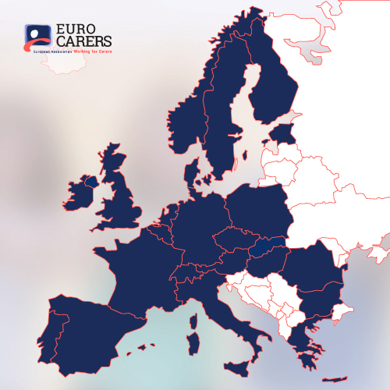
Le réseau Eurocarers
Réseau européen d'associations d’aidants et d'organisations actives dans la recherche relative au soin et à l'aidance
71 organisations membres dans 26 pays
Qui sont les aidants proches?
Un aidant est une personne qui prodigue des soins – en général non rémunérés - à quelqu’un souffrant d’une maladie chronique, d’un handicap ou de tout autre besoin en soins des longue durée, en dehors d’un contexte professionnel ou formel.

Slide 3
La Situation des aidants en Europe
Ce qui est personnel est politique
Selon la littérature académique:
Les aidants proches sont les plus grands pourvoyeurs de soins médicaux et sociaux
Ils représentent 10-25% de la population de l’UE
Les femmes fournissent 2/3 du soin en tant que (belles-)filles et épouses/compagnes.
L’aidant typique a entre 45 et 75 ans
Notes:
More than 100 million carers in Europe, which is an underestimation since we know there is a problem of self-recognition by carers themselves.
According to recent Eurofound data, 80% of care in Europe is provided by families, friends and other informal carers.
Advances in medicine also mean that carers find themselves having to deliver more and more sophisticated levels of care, with very little training and minimal support.
The probability of giving care depends to an important extent on the gender and the occupational status of the potential caregiver. From this data, it is apparent that informal care is mostly provided by women aged 45 to 75.

Slide 4
La valeur “économique” de l’aide informelle
Selon certaines estimations, la valeur de l’aide informelle bénévole dans les états membres de l’UE équivaut à entre 50 et 90% du coût global des soins de longue durée “formels”
L’impact budgétaire d’un remplacement du soin informel par des professionnels d’ici à 2070 impliquerait une augmentation de 130% de la part du PIB dévolue aux soins de longue durée en moyenne pour l’UE
→ Il n’y a pas d’accès universel aux soins de longue durée sans les aidants proches!
Notes:
The need for care had been expanding, slowly but inexorably, from the mid-20th century, driven by extensive socio-economic change as well as epidemiological factors. The increased and intensified need for ongoing personal care is reflected in population ageing statistics and the rising prevalence of long-term impairments and disabilities. Demand for childcare grew massively during this period too, not only as a corollary of the widening recognition of women’s rights to paid employment and a life outside the home, but also as a consequence of their growing need to seek paid work as economic life grew globally more precarious. The greater demands made of unpaid carers and professional care services reflected rising expectations about medical capabilities and social interventions, as well as a growing awareness of the rights of those who need long-term care (Fine, 2007; Yeandle et al, 2017). Providing care under these conditions is demanding, requiring prolonged and often increasing commitments over many years, frequently achieved through the massive personal sacrifice of unpaid and primarily female carers, most of whom are family members. Alongside this, formal care arrangements also developed rapidly through social policy initiatives and private care arrangements. In recent decades, market-based reforms to public systems in most advanced countries have emerged; these have not reduced costs, but led to significant growth in private expenditure, alongside continued public funding.
119 billion pounds - Source: www.carersuk.org/media/k2/attachments/Valuing_carers_2011 Carers_UK.pdf
Achieving Fairness for Family Carers – Election manifesto 2016 (family carers Ireland)

Slide 5
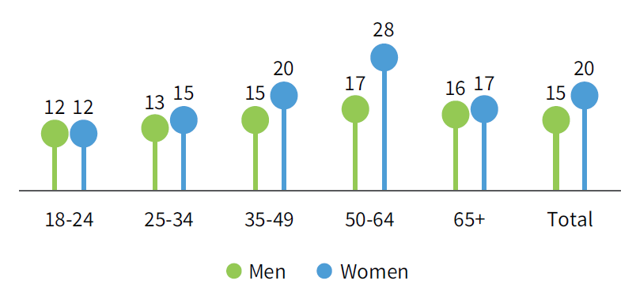
Aide à un proche ou ami en situation de handicap/infirmité
Proportion d’hommes et de femmes dans different groupes d’âge prodiguant des soins (au moins un fois par semaine) – EQLS 2016
Notes:
Proportion of men and women in different age groups providing care (at least once a week).

Slide 6
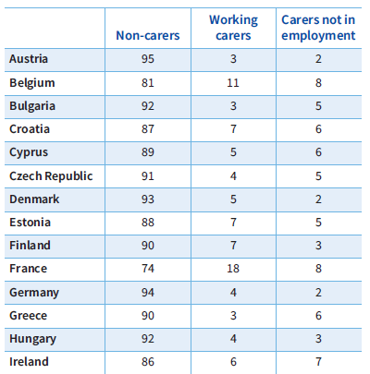
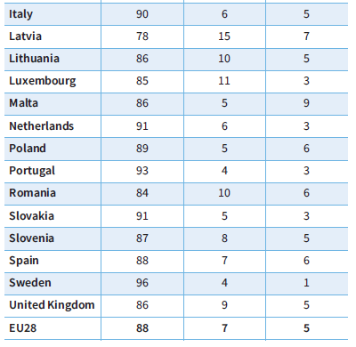
Aidants réguliers de personnes en situation de handicap/infirmité, parmi les 18–64 ans, par pays (%)
L’expression ‘Aidants réguliers’ se réfère aux personnes prodiguant des soins à quelqu’un en situation de handicap ou infirmité plusieurs jours par semaine ou tous les jours - Eurofound 2018
Notes:
Aidants réguliers de personnes en situation de handicap/infirmité, parmi la population en âge de travailler (18–64 ans), par pays (%)

Slide 7
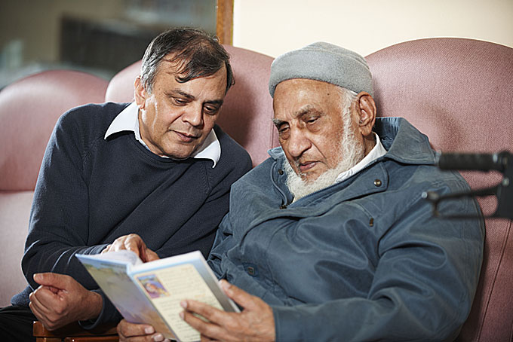
Impact de l’aidance
Correlation claire entre l’aidance et:
Conciliation vie professionnelle / vie familiale
Exclusion sociale et pauvreté
Santé et bien-être
“En tant qu’aidant, vous n’avez aucune vie sociale. Je suis aidant depuis 20 ans.
Je n’ai pas l’impression de faire partie de la société. Je me sens comme un marginal”

Slide 8
Situation sociale et économique des aidants réguliers en âge de travailler (18–64)
L’expression ‘Aidants réguliers’ se réfère aux personnes prodiguant des soins à quelqu’un en situation de handicap ou infirmité plusieurs jours par semaine ou tous les jours - Eurofound 2018

Slide 9
Aidance et COVID-19

Slide 10
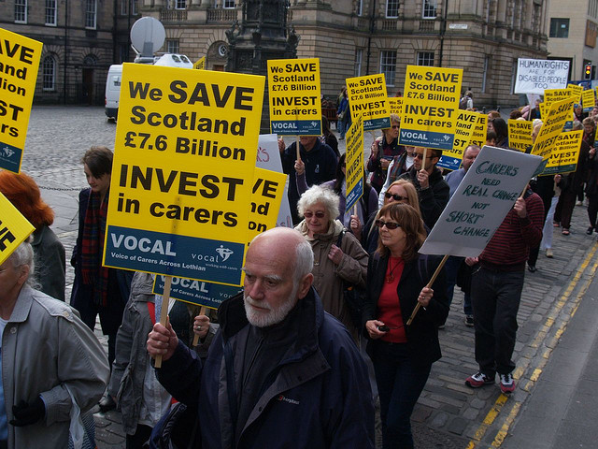
Que veulent les aidants?
Soutien financier: un revenu base sur un salaire minimum
Emploi: conditions flexibles, congé aidant payé ou pas
Crédits pension reflétant la période de soins
Congé régulier
Formation
L’aidance n’est pas la source de mon stress et de mon épuisement, c’est la bataille constante pour l’accès aux services!
Notes:
Informal caregivers are supported through information provision, social and psychological services and by the existence of day centres and short-stay care centres which allow to alleviate temporarily the burden of informal care-giving. Carers’ allowances are also available in some countries (e.g. Belgium), often paid by municipalities, but their amount varies substantially. Besides, this allowance is often very small which means that the support provided is limited, it does not constitute a direct cash compensation for the care provided and it mainly aims to recognise the status of informal carers (already a positive step forward).
Eurobarometer 2011
Provide financial remuneration for carers
Facilitate flexible working hours
Allow leave from work for care reasons
Give pension credits for care time
Provide a right to part-time work
Provide training
Fund respite care during care-giver holidays.
Out of the 23 countries in Europe which offer any type of financial support, only 9 offer direct support in the form of a carer allowance
Carers face 77% higher utility bills and 67% higher transport costs (UK)
A third of carers are in debt (UK)
Respite care services are provided in 21 European countries. They are the most common type of services provided to carers in Europe.
Training and information are provided in 17 countries, counselling in 12 countries

Slide 11
Socle européen des droits sociaux
Chapitre 1: Egalité des chances et accès au marché de l’emploi
Education, formation et apprentissage tout au long de la vie
Egalité entre les femmes et les hommes
Egalité des chances
Soutien actif à l’emploi
Chapitre 3 : Protection et insertion sociales
Services de garde d’enfants et d’aide aux enfants
Protection sociale
Prestations de chômage
Revenu minimum
Revenus et pensions de vieillesse
Soins de santé
Inclusion des personnes handicapées
Soins de longue durée
Logement et aide aux sans-abri
Accès aux services essentiels
Chapitre 2: Conditions de travail équitables
Emploi sûr et adaptable
Salaires
Info sur les conditions d’emploi et protection en cas de licenciement
Dialogue social et participation des travailleurs
Equilibre vie professionnelle et vie privée
Environnement de travail sain, sûr et adapté et protection des données
Notes:
A year ago, the EU Pillar of Social Rights reaffirmed that everyone has the right to affordable long-term care services of good quality, in particular home-care and community-based services.
The communication around the Pillar states that the availability, accessibility and affordability of the care infrastructure are crucial to allow carers to stay in or join the labour market. Yet, the only concrete measure introduced in this proposal is the entitlement to a minimum amount of 5 paid days of care leave per year. No tangible proposals are made to improve the care infrastructure.
The proposal does not specify what ‘flexible working arrangements for carers’ would amount to in practice in order to allow carers to keep their jobs while adapting to changing care needs of their relatives. The European Commission merely expects to monitor flexible working arrangements as part of the European Semester and to share best practices on flexible working arrangements and on initiatives such as labels and certifications for employers with a good work-life balance. It will be important to monitor closely which working carers will benefits from flexible working given that larger firms with established worker representation might be more likely to offer these. Low-paid workers in precarious work will find it most difficult to demand flexible work to care for dependent relatives, therefore their situation demands additional support.
The key problem that in many countries the care responsibility lies solely with the – mostly female – family members due to a lack of community care options, illustrates the need for clear proposals to improve the provision of these. Without affordable, accessible respite care options, carers will not be able to take out time for themselves.
Potential EU actions on supporting carers
Access, affordability and quality of care services are a critical issue in many Member States, yet the European Commission’s country reports rarely mention these. We would welcome it if the European Semester included issues related to social services and care as this would raise awareness of these issues and allow for more comparison and mutual learning in this area. Finally, the proposal lacks definitive guidelines on how Member States will be incentivised to use the European Social Fund, the European Regional Development Fund and the European Fund for Strategic Investments to invest in care services. Overall, this proposal addresses some important issues but falls short of facilitating a truly ‘new start’ for parents and carers.

Slide 12
Socle européen des droits sociaux
Chapitre 1: Egalité des chances et accès au marché de l’emploi
Education, formation et apprentissage tout au long de la vie
Egalité entre les femmes et les hommes
Egalité des chances
Soutien actif à l’emploi
Chapter 3 : Social protection and inclusion
Services de garde d’enfants et d’aide aux enfants
Protection sociale
Prestations de chômage
Revenu minimum
Revenus et pensions de vieillesse
Soins de santé
Inclusion des personnes handicapées
Soins de longue durée
Logement et aide aux sans-abri
Accès aux services essentiels
Chapitre 2: Conditions de travail équitables
Emploi sûr et adaptable
Salaires
Info sur les conditions d’emploi et protection en cas de licenciement
Dialogue social et participation des travailleurs
Equilibre vie professionnelle et vie privée
Environnement de travail sain, sûr et adapté et protection des données

Slide 13
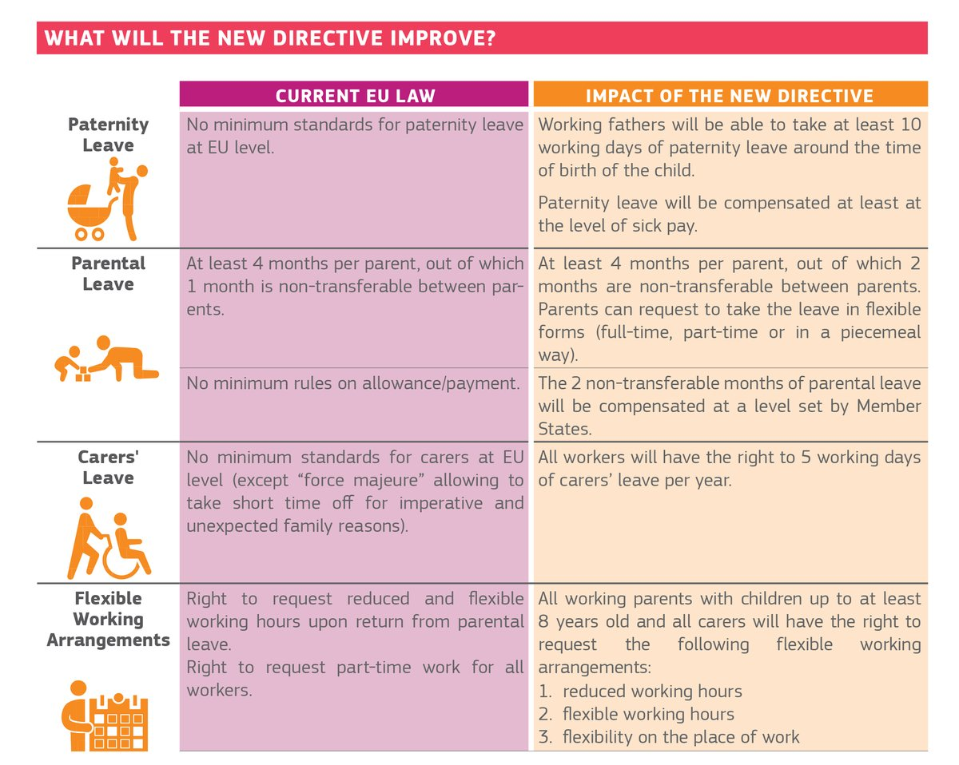
Directive européenne Equilibre entre vie professionnelle et vie privée

Slide 14
Le bien-fondé d’une stratégie européenne sur l’aidance
Notes:
The 4 main challenges facing care systems – a growing demand for care, a declining supply of potential (professional and informal) carers, a quality and financial sustainability issue - are consistent across all member states. The negative impact of informal care on carers’ working and living conditions is also a common issue across Europe.
Over the last few years, much has been achieved in taking forward the carers’ agenda at international, EU and – to some extent – national and regional level. But policy developments of relevance for carers concern a broad set of policies in various fields and they have often been implemented in a fragmented way. As a result, they have not always resulted in real improvements for the daily life of carers.
So, the idea with this Strategy is to elaborate on what this actually means by defining the 10 Steps that we see as essential to develop a comprehensive and coherent carer-friendly policy environment. I should add that choice is at the core of this Strategy. We indeed believe that People should have the right to choose freely whether they want to be a carer, and to what extent they want to be involved in caring; people needing care should have the right to choose who they wish to be their carers.

Slide 15
STEP 10
Prendre en consideration la perspective dans l’aidant dans toute politique pertinente
STEP 9
Prévenir la pauvreté des aidants et leur permettre de maintenir une vie sociale et professionnelle active
STEP 8
Permettre ausx aidants d’accéder à la formation et reconnaître les acquis de leur expérience
STEP 7
Permettre aux aidants de souffler
STEP 6
Prêter attention à la santé de l’aidant et prévenir les impacts sanitaires indésirables
STEP 5
Faciliter l’accès des aidants à l’information et au conseil relatifs au soin, à l’aidance et à la conciliation vie/aidance
STEP 4
Soutenir des partenariats de soins intégrés et accessibles au plus près des besoins
STEP 3
^{Evaluer le besoin des aidants}
STEP 2
^{Identifier les aidants}
STEP 1
Définir et reconnaître les aidants
Notes:
Issues concerning informal carers are multidimensional and require a cross-cutting and reaching beyond the care realm. Transposition of the Directive must be an opportunity to further develop long-term care services (quality, person-centred care for persons in need of support and/or care) and a stream of support for carers who to enable them to continue to work and not drop out form the labour market).
NGOs representing civil society groups concerned by the Directive must be consulted during the transposition process, and the social partners must be encouraged to secure collective agreements on Work-Life Balance to drive change in workplace culture.
Need to involve and mobilise all relevant stakeholders including NGOs, local and regional authorities, service providers
This is what the Eurocarers strategy is about – summarised here in 10 steps that we see as essential to develop a comprehensive and coherent carer-friendly policy environment. Choice is at the core of this Strategy. We indeed believe that People should have the right to choose freely whether they want to be a carer, and to what extent they want to be involved in caring. Equally of course, people needing care should have the right to choose who they wish to be their carers.

Slide 16
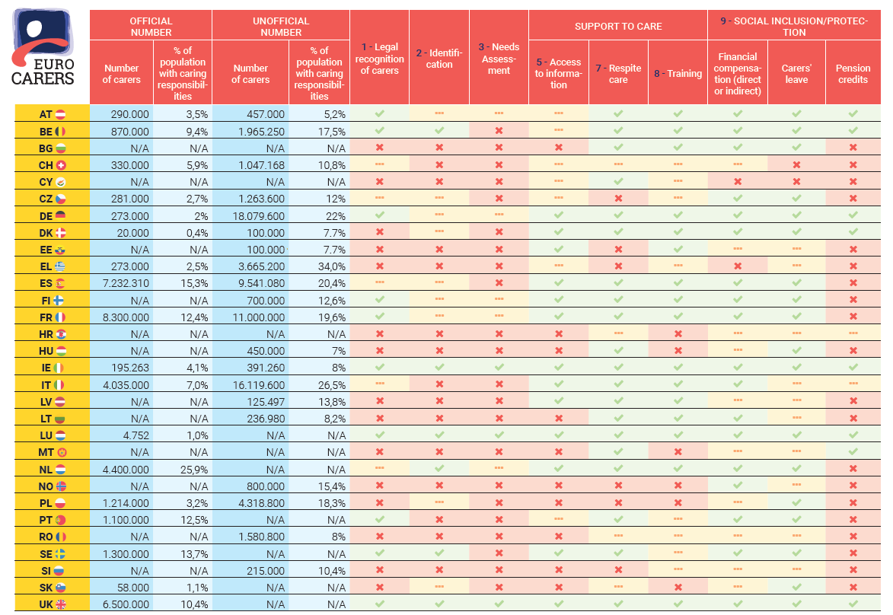

Slide 17
Journée européenne des aidants

Slide 18
Merci de votre attention
www.eurocarers.org
sy@eurocarers.org

